Slide 1

Predicting Student Performance using Machine Learning
Emmanuel De Vera
16/06/25

Slide 2
Task Statement and Motivations
Goal: Can we predict a student’s GPA based on their academic, behavioral, and social background?

Slide 3
Task Statement and Motivations
Goal: Can we predict a student’s GPA based on their academic, behavioral, and social background?
Motivations:
General curiosity on what factors matter to success
Relevance as a master’s student; apply insights gained
Learn and run large-scale analysis with Apache Spark

Slide 4
Data Origin and Summary
Source: Kaggle neuralsorcerer/student-performance/data
Description: Dataset of high-school student performance

Slide 5
Data Origin and Summary
Source: Kaggle neuralsorcerer/student-performance/data
Description: Dataset of high-school student performance
Example Features:
AttendanceRate: Fraction of school days attended (0.70-1.00)
ParentalEductation: Highest education (HS, SomeCollege, Bachelors+)
Extracurricular: Participation in clubs/sports (1 = yes, 0 = no)
Romantic: Currently in a romantic relationship (1 = yes, 0 = no)

Slide 6
Data Origin and Summary
Source: Kaggle neuralsorcerer/student-performance/data
Description: Dataset of high-school student performance
Example Features:
AttendanceRate: Fraction of school days attended (0.70-1.00)
ParentalEductation: Highest education (HS, SomeCollege, Bachelors+)
Extracurricular: Participation in clubs/sports (1 = yes, 0 = no)
Romantic: Currently in a romantic relationship (1 = yes, 0 = no)
ML Task: GPA Prediction using Regression

Slide 7
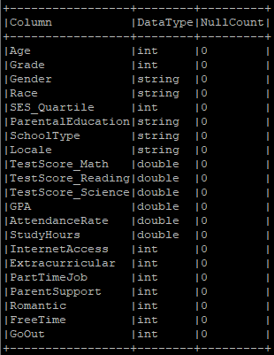
Exploratory
Data Analysis
Provided Data Files:
train.csv 1.23 GB, validation.csv 158MB, test.csv 158MB
Due to sufficient size, validation.csv alone will be used to derive the train and test sets (omitting train and test csv)
Notes:
Take some time to go through some more features
No need to do imputation

Slide 8
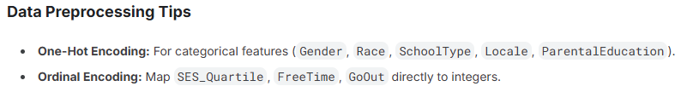
Exploratory
Data Analysis
Provided Data Files:
train.csv 1.23 GB, validation.csv 158MB, test.csv 158MB
Due to sufficient size, validation.csv alone will be used to derive the train and test sets (omitting train and test csv)
Initial Instance Count: 999,229 (254,604 post-sampling)
Initial Feature Count: 21 (35 post-preprocessing)
Notes:
Take some time to go through some more features
No need to do imputation

Slide 9
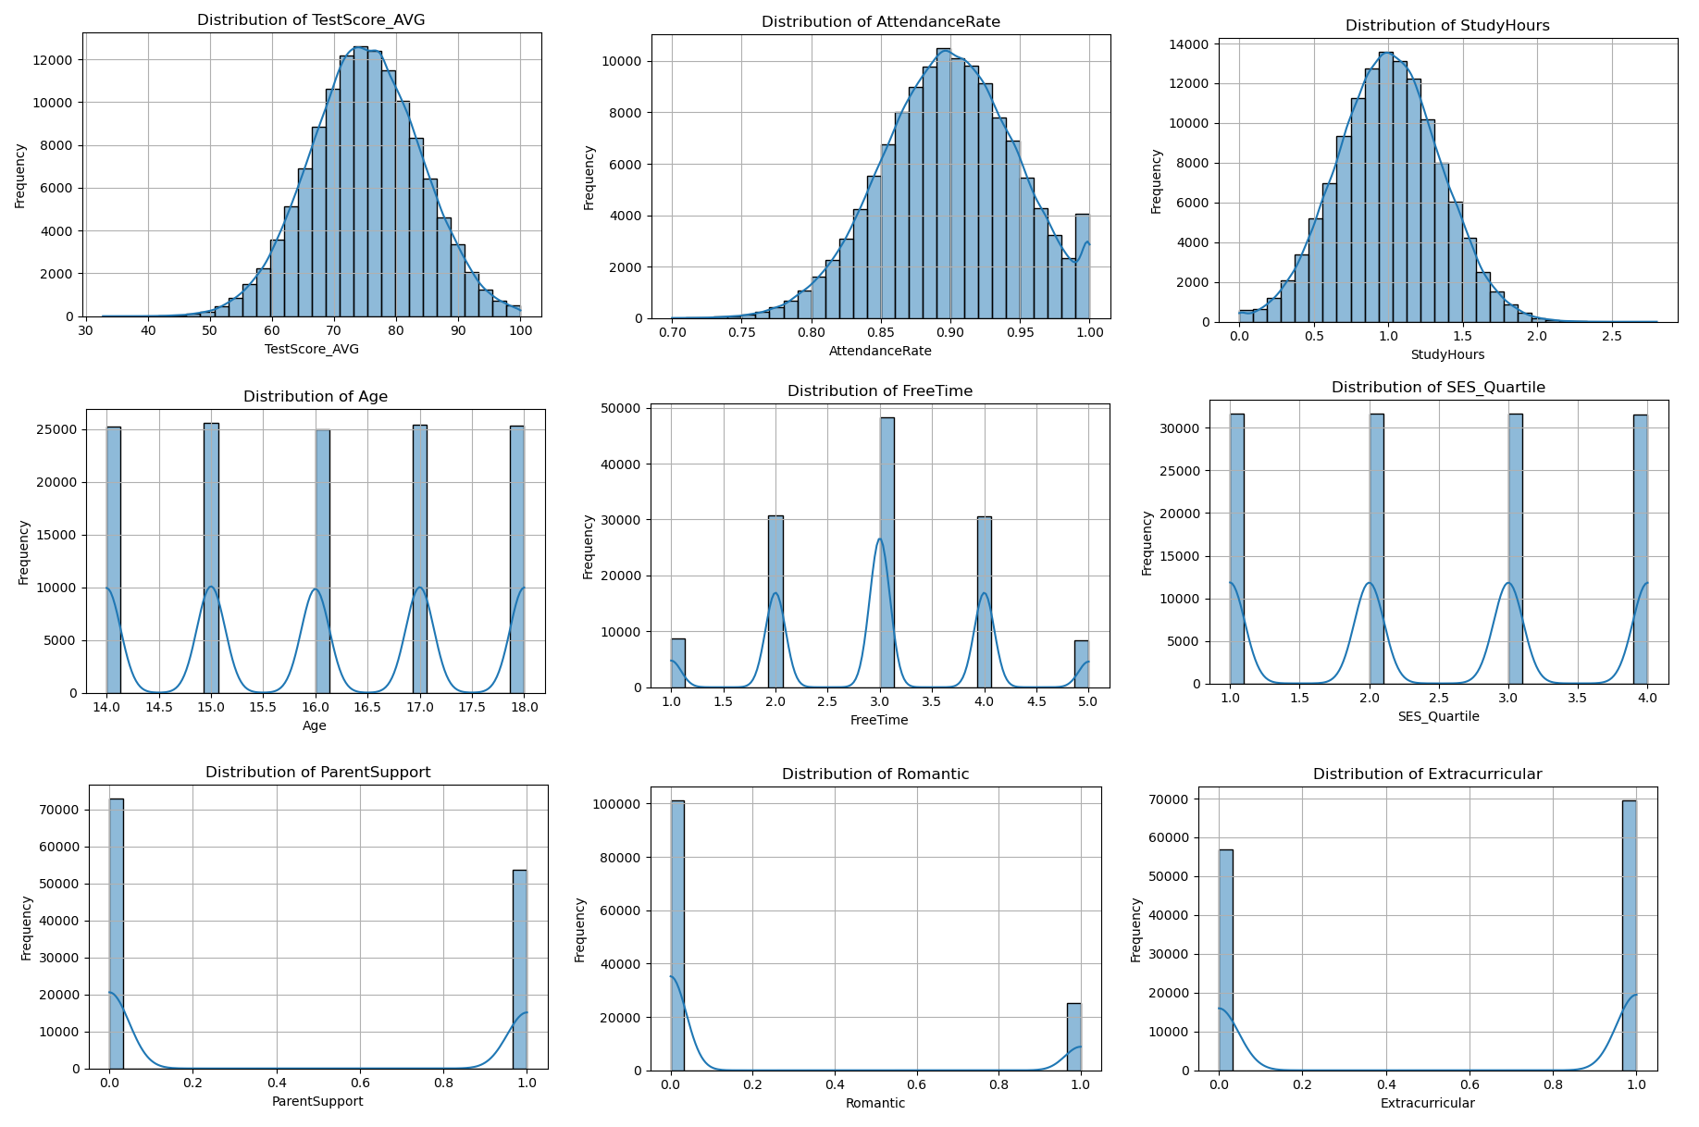
Exploratory
Data Analysis
Feature Distribution:
The distribution of numerical features was plotted to inform the scaling strategy used in later preprocessing
Notes:
Point out that TestScore is 30 to 100 but AttendanceRate is 0-1.
Scaling ensures that all features contribute equally to the model, preventing features with larger scales from dominating the learning process
Standard scaling is less effective for data that is not normally distributed
The distribution of integer-based features are used to inform the balance of values in their representation.

Slide 10
Exploratory
Data Analysis
Feature Distribution:
The distribution of numerical features was plotted to inform the scaling strategy used in later preprocessing
Addressing Data Leakage:
EDA is fine prior to train/test splitting as these are data-agnostic operations not involving model training
Splitting is done prior to pre-processing to ensure statistics like mean for scaling are only calculated from the train set
Notes:
Point out that TestScore is 30 to 100 but AttendanceRate is 0-1.
Scaling ensures that all features contribute equally to the model, preventing features with larger scales from dominating the learning process
Standard scaling is less effective for data that is not normally distributed
The distribution of integer-based features are used to inform the balance of values in their representation.

Slide 11
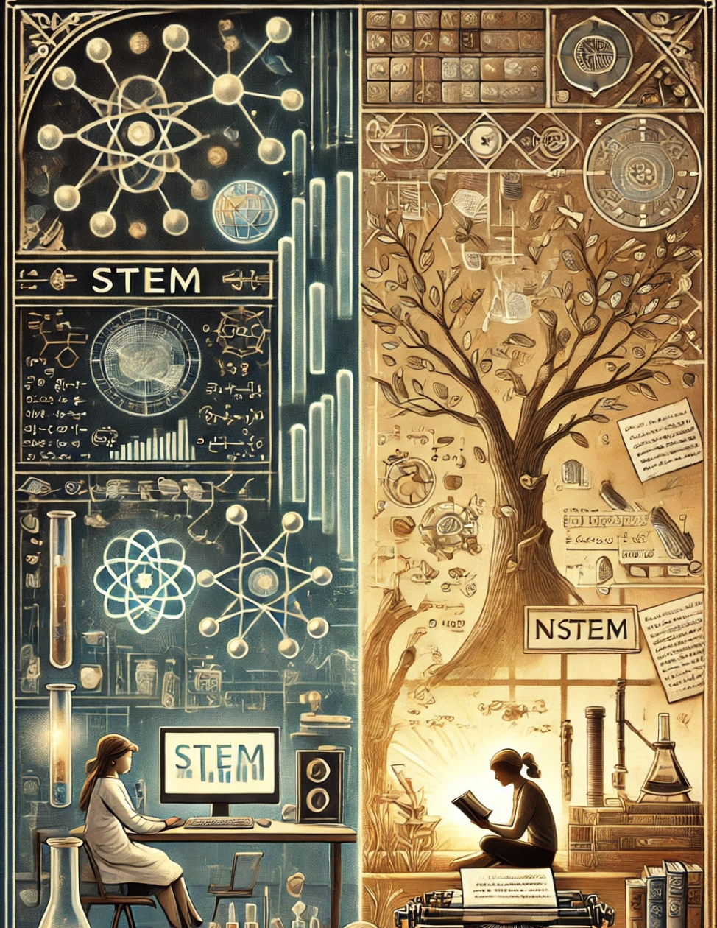
Feature Engineering
1. Stem_Ratio:
((TestScore_Math + TestScore_Science) / 2) / TestScore_Reading
Purpose: Quantify a student’s relative strength in STEM subjects compared to their reading/writing ability
Example: 1.12 (Student scores higher amid STEM subjects)
Notes:
Take some time to go through some more features
No need to do imputation

Slide 12
Feature Engineering
1. Stem_Ratio:
((TestScore_Math + TestScore_Science) / 2) / TestScore_Reading
Purpose: Quantify a student’s relative strength in STEM subjects compared to their reading/writing ability
Example: 1.12 (Student scores higher amid STEM subjects)
2. TestScore_AVG:
(TestScore_Math + TestScore_Science + TestScore_Reading) / 3
Purpose: Quantify Charles Spearman’s 1904 study “Students who did well in one subject, tended to do well in them all”
Reference: Veritasium, I took an IQ Test (YouTube) 08/04/23
Notes:
Take some time to go through some more features
No need to do imputation

Slide 13
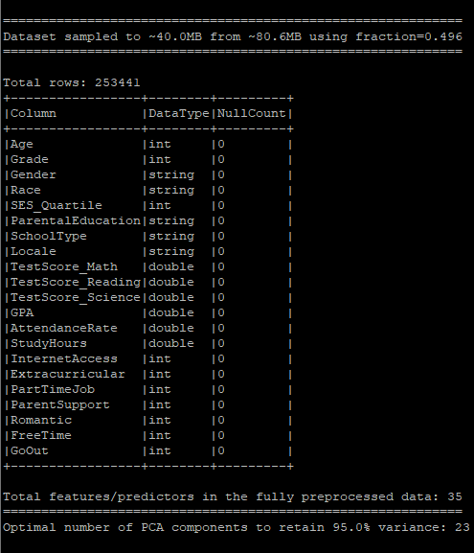
Data Preprocessing
Data Splitting:
160MB validation.csv sampled to 40MB (~250,000)
0.8 Train to 0.2 Test split (Reverse Pareto Principle)
~200,000 training instances to ~50,000 testing instances
Notes:
Actually 160 sampled to 80MB to obtain student.csv to fit the submission file system. Sampled again to 40MB for adequate size and speed
No need to do Data Cleaning. No impuration
No need to remove outliers fairly within distribution
One thing I could improve is to show an image of the preprocessed data

Slide 14
Data Preprocessing
Data Splitting:
160MB validation.csv sampled to 40MB (~250,000)
0.8 Train to 0.2 Test split (Reverse Pareto Principle)
~200,000 training instances to ~50,000 testing instances
Feature Transformation:
StringIndexer and OneHotEncoder for Categorical features (Expands 5 categorical features into 18 One-hot features)
VectorAssembler to convert all (now numerical) features into vector format which is required for PySpark’s Mlib
StandardScaler over MinMaxScaler informed by EDA to ensure features contribute equally to the model
Notes:
Actually 160 sampled to 80MB to obtain student.csv to fit the submission file system. Sampled again to 40MB for adequate size and speed
No need to do Data Cleaning. No impuration
No need to remove outliers fairly within distribution
One thing I could improve is to show an image of the preprocessed data

Slide 15
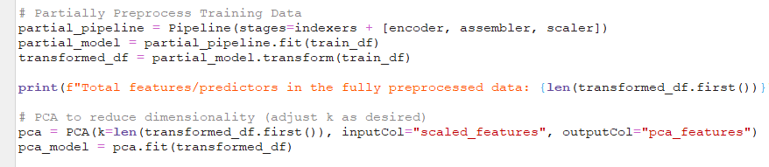
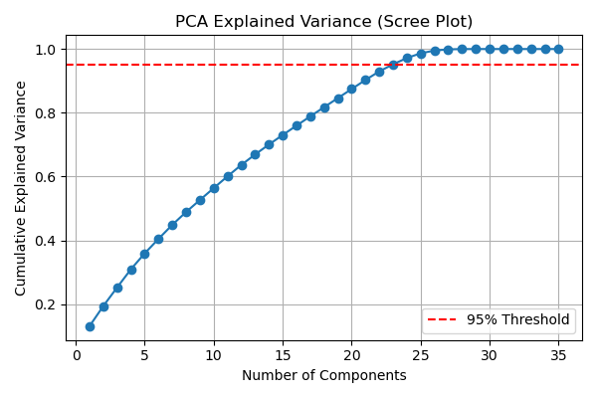
Data Preprocessing
Principal Component Analysis:
Transform the training set through a pipeline to be fit for PCA
Extract the cumulative explained variance for each added PC
Choose the smallest k such that the target EV is satisfied
PCA is defined again with the optimal k found, ready for use
Notes:
Actually 160 sampled to 80MB to obtain student.csv to fit the submission file system. Sampled again to 40MB for adequate size and speed
No need to do Data Cleaning. No impuration
No need to remove outliers fairly within distribution
One thing I could improve is to show an image of the preprocessed data

Slide 16
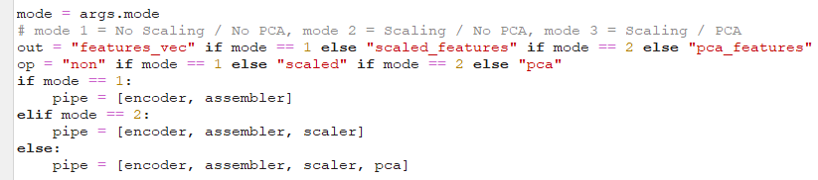
Data Preprocessing
Principal Component Analysis:
Transform the training set through a pipeline to be fit for PCA
Extract the cumulative explained variance for each added PC
Choose the smallest k such that the target EV is satisfied
PCA is defined again with the optimal k found, ready for use
Program Mode of Operation:
Notes:
Actually 160 sampled to 80MB to obtain student.csv to fit the submission file system. Sampled again to 40MB for adequate size and speed
No need to do Data Cleaning. No impuration
No need to remove outliers fairly within distribution
One thing I could improve is to show an image of the preprocessed data

Slide 17
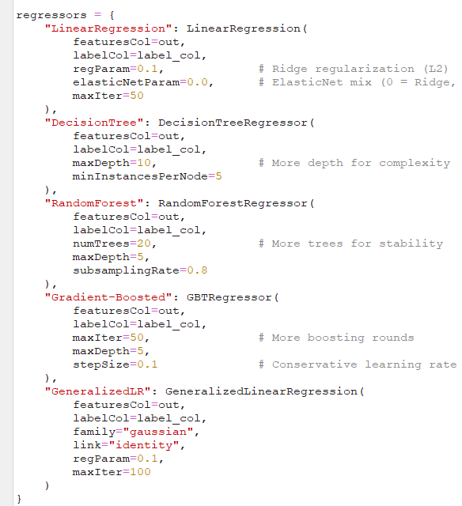
Spark ML Regressors
Motivation:
Some regressors are better at capturing simple linear patterns
Others excel at learning non-linear relationships/interactions
Testing a variety of model gives insight into underlying structure
Identify the best regressor to be taken for further fine tuning
Notes:
Luckily SparkML regressors are limited to these and a few obscure and specific ones that are beyond scope (not yet learned) or irrelevant to the task:
Survival regression
Isotonic regression
Factorization machines regressor

Slide 18
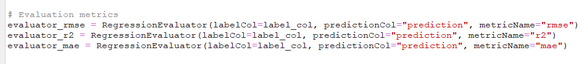
Spark ML Regressors
Motivation:
Some regressors are better at capturing simple linear patterns
Others excel at learning non-linear relationships/interactions
Testing a variety of models gives insight into underlying structure
Identify the best regressor to be taken for further fine tuning
Evaluators:
Elapsed Time is also measured (before fitting to after prediction)
Notes:
Luckily SparkML regressors are limited to these and a few obscure and specific ones that are beyond scope (not yet learned) or irrelevant to the task:
Survival regression
Isotonic regression
Factorization machines regressor

Slide 19
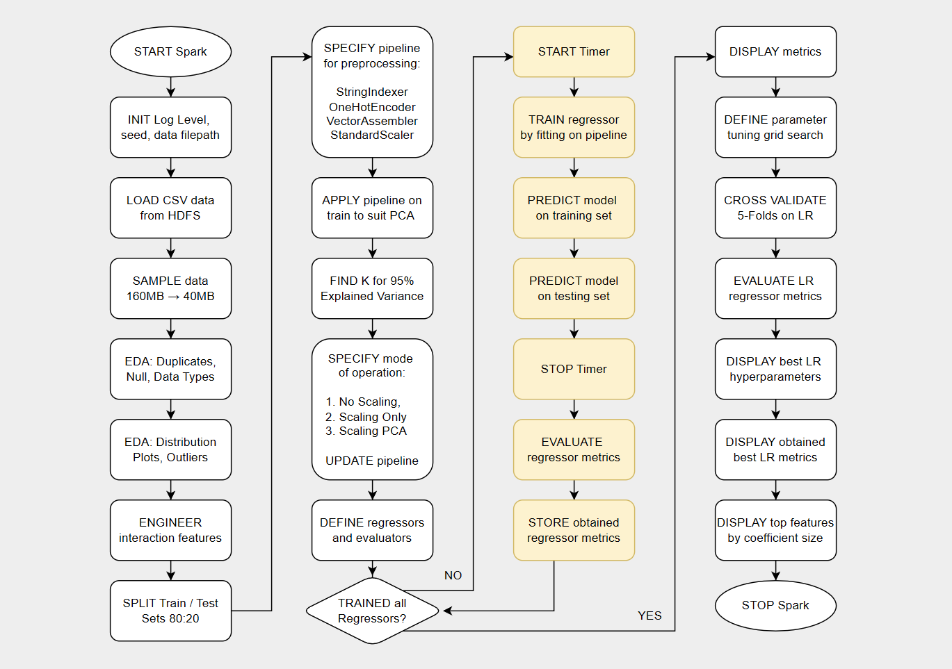

Slide 25
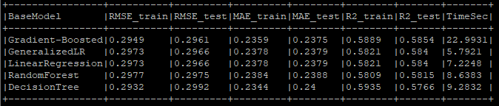
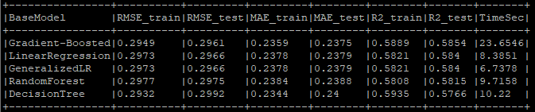
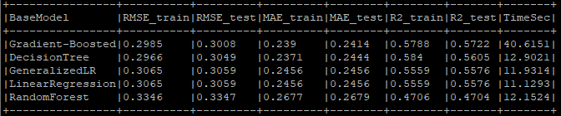
No Scaling / No PCA
Results
Scaling had no impact on performance but added marginal computational overhead
Expected with scale-invariant tree models but quite surprising for distance-based LR
Scaling / No PCA
Scaling / PCA

Slide 26
No Scaling / No PCA
Results
Scaling had no impact on performance but added marginal computational overhead
Expected with scale-invariant tree models but quite surprising for distance-based LR
Scaling is to prevent feature domination due to inconsistent distance measures
Dominating features pre scaling are the same features that perform well scaled
Scaling / No PCA
Scaling / PCA

Slide 27
No Scaling / No PCA
Results
Scaling had no impact on performance but added marginal computational overhead
Expected with scale-invariant tree models but quite surprising for distance-based LR
Scaling is to prevent feature domination due to inconsistent distance measures
Dominating features pre scaling are the same features that perform well scaled
Linear Regression performs well, outpacing Random Forest and just behind GBoosting
The underlying relationship is rather simple, GPA correlates strongly with certain features
Scaling / No PCA
Scaling / PCA

Slide 28
No Scaling / No PCA
Results
All models show a drop in performance among all regressor evaluation metrics
Time has also increased as Spark ML converts vectors to dense format for PCA
Scaling / No PCA
Scaling / PCA
Notes:
Decision Tree is overfitting, makes sense because just one. This leads to higher memory usage and slower operations downstream
We want to know which features are responsible for getting better grades, PCA eliminates this interpretability

Slide 29
No Scaling / No PCA
Results
All models show a drop in performance among all regressor evaluation metrics
Time has also increased as Spark ML converts vectors to dense format for PCA
The dimensionality reduction removed key feature interactions, losing predictive power
Particularly RF which relies on feature splits
Scaling / No PCA
Scaling / PCA
Notes:
Decision Tree is overfitting, makes sense because just one. This leads to higher memory usage and slower operations downstream
We want to know which features are responsible for getting better grades, PCA eliminates this interpretability

Slide 30
No Scaling / No PCA
Results
All models show a drop in performance among all regressor evaluation metrics
Time has also increased as Spark ML converts vectors to dense format for PCA
The dimensionality reduction removed key feature interactions, losing predictive power
Particularly RF which relies on feature splits
Confirms that PCA is not beneficial for this data, especially as it limits interpretability
Confirms there exists a set of meaningful features, aligning with past observations.
Scaling / No PCA
Scaling / PCA
Notes:
Decision Tree is overfitting, makes sense because just one. This leads to higher memory usage and slower operations downstream
We want to know which features are responsible for getting better grades, PCA eliminates this interpretability

Slide 31
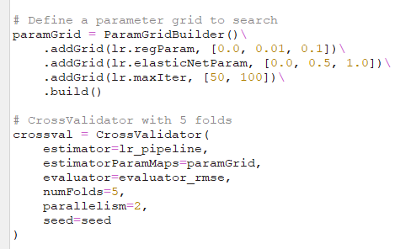
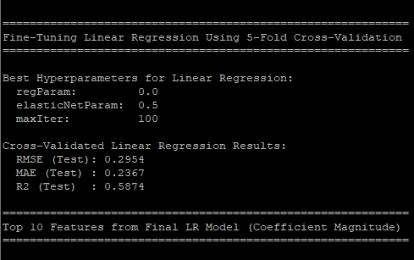
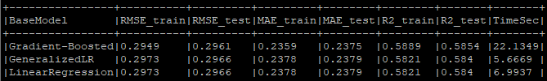
Results
Assignment 2 Regression concluded that lasso performed best due to shrinkage to 0
As Linear Regression is acceptable, I aim to fine tune it to determine if the above holds
Notes:
Decision Tree is overfitting, makes sense because just one. This leads to higher memory usage and slower operations downstream
We want to know which features are responsible for getting better grades, PCA eliminates this interpretability
Regularization helps fight overfitting to noise.

Slide 32
Results
Assignment 2 Regression concluded that lasso performed best due to shrinkage to 0
As Linear Regression is acceptable, I aim to fine tune it to determine if the above holds
On the contrary, Linear regression without regularization outperforms in all metrics
Highlights that the underlying relationship between features and the label is truly linear
Notes:
Decision Tree is overfitting, makes sense because just one. This leads to higher memory usage and slower operations downstream
We want to know which features are responsible for getting better grades, PCA eliminates this interpretability
Regularization helps fight overfitting to noise.

Slide 33
Results
Assignment 2 Regression concluded that lasso performed best due to shrinkage to 0
As Linear Regression is acceptable, I aim to fine tune it to determine if the above holds
On the contrary, Linear regression without regularization outperforms in all metrics
Highlights that the underlying relationship between features and the label is truly linear
Base Linear regression is already optimal
Regularization shrinks useful coefficients unnecessarily, especially amid clean data
Notes:
Decision Tree is overfitting, makes sense because just one. This leads to higher memory usage and slower operations downstream
We want to know which features are responsible for getting better grades, PCA eliminates this interpretability
Regularization helps fight overfitting to noise.

Slide 34
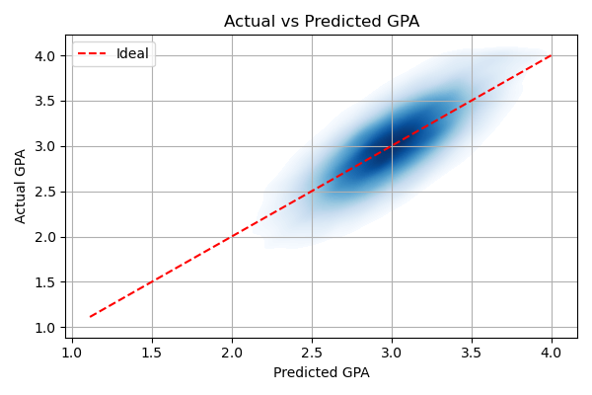
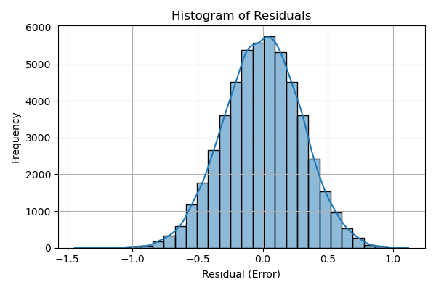
Results
Predictions closely track the GPA as contour density is relatively tight amid the ideal line
Symmetry in residuals suggests no major bias in underpredicting or overpredicting
Notes:
If reframed as classification into ranges 0-1, 1-2, 2-3, 3-4, the model would work well.

Slide 35
Results
Predictions closely track the GPA as contour density is relatively tight amid the ideal line
Symmetry in residuals suggests no major bias in underpredicting or overpredicting
On average, predictions are off by 0.2367 GPA (MAE). This is ~5.9% error of the total GPA range (0.2367 / 4.0 = 0.059175)
Larger errors inflate the RMSE calculation to 0.295. This is still ~7.4% of the GPA range
Notes:
If reframed as classification into ranges 0-1, 1-2, 2-3, 3-4, the model would work well.

Slide 36
Results
Predictions closely track the GPA as contour density is relatively tight amid the ideal line
Symmetry in residuals suggests no major bias in underpredicting or overpredicting
On average, predictions are off by 0.2367 GPA (MAE). This is ~5.9% error of the total GPA range (0.2367 / 4.0 = 0.059175)
Larger errors inflate the RMSE calculation to 0.295. This is still ~7.4% of the GPA range
Confirms there exists a set of meaningful features, aligning with past observations.
Notes:
If reframed as classification into ranges 0-1, 1-2, 2-3, 3-4, the model would work well.

Slide 37
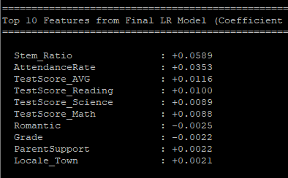
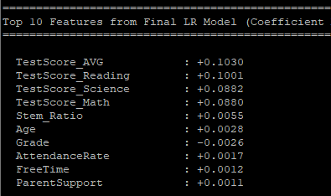
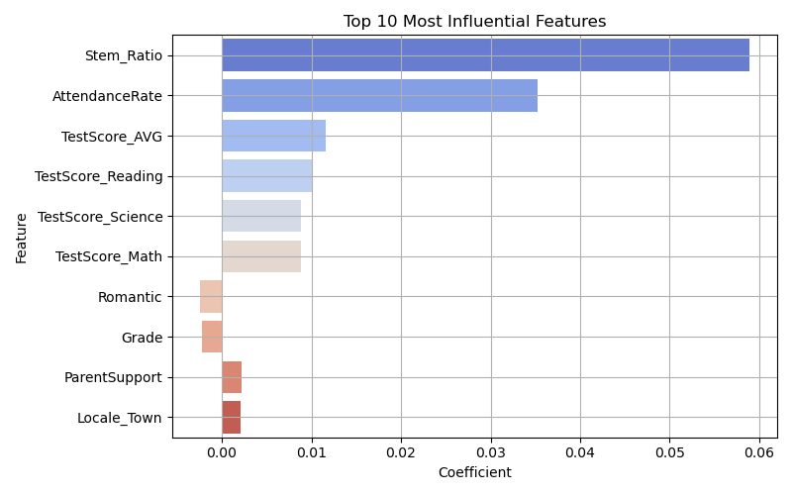
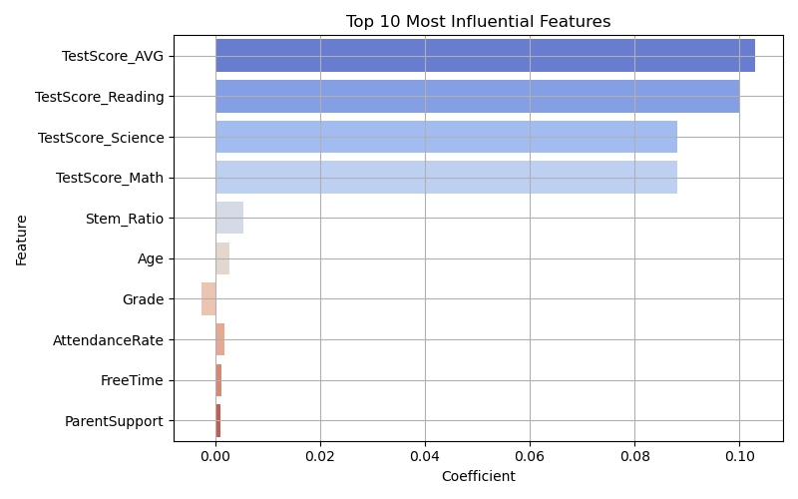
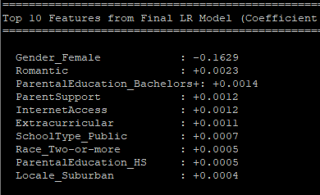
No Scaling / No PCA
Scaling / No PCA
Reasons
GPA is very linearly correlated to Test Scores
Interestingly there’s a positive Stem_Ratio!
PCA gives nonsensical feature coefficients due to its mishmash of features for EV
Regardless we have obtained a usable predictor of GPA given such data is provided
Notes:
If reframed as classification into ranges 0-1, 1-2, 2-3, 3-4, the model would work well.

Slide 38
Conclusion
Achieved low RMSE using model selection and cv tuning
Engineered features that had high coefficient magnitude
Gained insight on coefficients that lead to a higher GPA
Understood the effects of scaling and PCA on our data
Learned how to use the Hadoop Cluster and HDFS
Learned how to use Apache Spark ML on big data
Communicated an end-to-end machine learning task

Slide 39
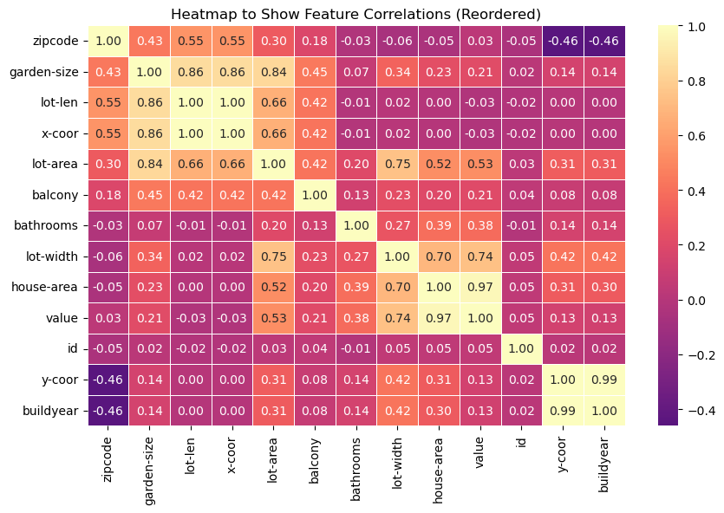
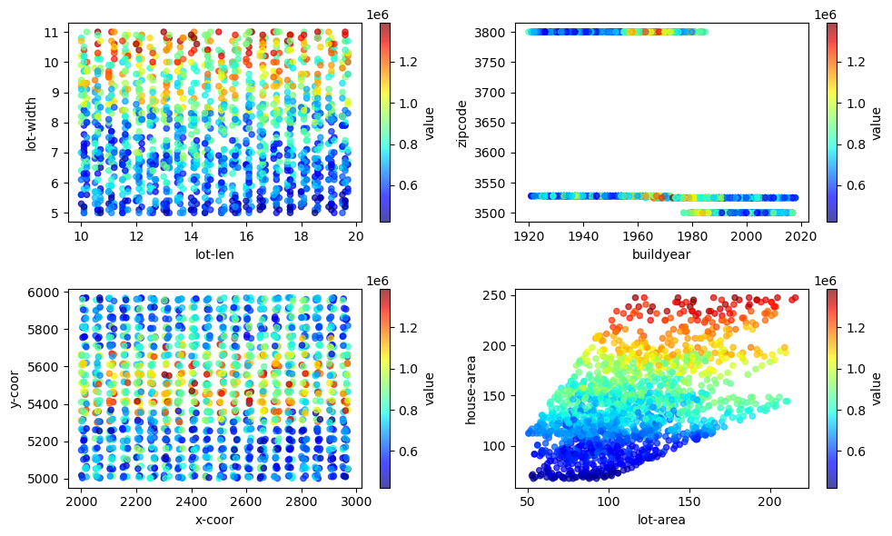
Future Directions and Improvements
Biased toward Big Data and having many features
Future work may see more rigorous feature selection
Remove Test Scores and consider only social factors for a more complex/interesting look into GPA prediction

